Slide 1
Java Input-Output
Object Oriented Programming with Java
Chapter 7
FPTU Da Nang – IT Department

Slide 2
Objectives - Contents
File
RandomAccessFile
Streams
  Low-Level Streams
  High-Level Filter Streams
Readers, and Writers
  Low-level reader and writer
  High-level reader or writer
Object Streams and Serialization

Slide 3
General introduction
Java Input and output classified
  Access mechanism
    Random Access – RandomAccessFile
      allow simultaneous read and write
    Sequential access - using stream
      Separate class for read and write operation
  Data format
    Text :
      Reader : for reading text data
      Writer: for writing text data
    Binary
      InputStream: stream of binary data to read
      OutputStream: stream of binary data to write

Slide 4
General introduction
  Access level
    Low level
      read and write directly on the input/output device
      read or write 1 unit of data (1 byte – 1 character)
    High level
      Using cache for reading and writing block of data
  Utility I/O class
    InputStreamReader, OutputStreamWriter : convert binary to text
    Scanner : helpful class for input from console
  Ex: FileInputStream, FileOutputStream
  BufferedReader, BufferedWriter, FileReader..
  Class for interact with OS File System
    File

Slide 5
File – access OS file system
java.io.File
  Used to represent file or directory names on the OS's file system
  Not for reading and writing data
Constructor
  File(String pathname);
  File(String dir, String subpath);
  File(File dir, String subpath);
    File f1 = new File(“C:\\a”);
    File f2 = new File(f1, “Xyz.java”);
    Note: new File(): No files are created on disk.

Slide 6
File – methods
boolean exists(): check whether file name or directory exists?
String getAbsolutePath(): absolute path.
String getName(): returns the file or directory name.
String getParent(): parent folder name
boolean isDirectory(): is the directory?
boolean isFile(): is the file?
String[] list(): list namesAsianc files & subdirectories of the directory

Slide 7
File – methods
boolean canRead()
boolean canWrite()
boolean delete() delete files and folders
long length()
boolean mkdir() create folder
boolean renameTo(File newname) rename file or folder

Slide 8
RandomAccessFile
RandomAccessFile
  random access, using cursor for seeking read/write data at any position on file
  Can read | write block of data.
Constructor
  RandomAccessFile(String file, String mode)
  RandomAccessFile(File file, String mode)
  + reading mode "r" - read write “rw.”
Support read and write data in primitive type
  Each read/write operation automatically moves the cursor to the new position
  long length() throws IOException
  void seek(long position) throws IOException
  move cursor to specific position

Slide 9
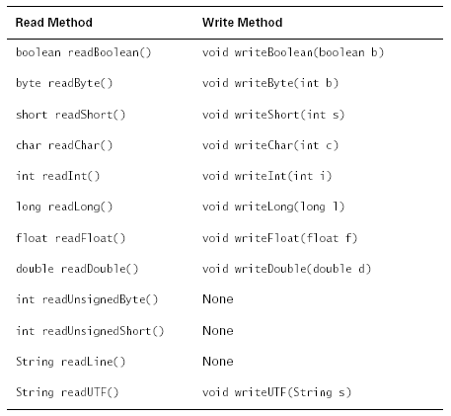
RandomAccessFile..

Slide 10
Unicode & UTF
Java uses two representations of text
  Unicode encoding for text representation in memory
  UTF for input and output
Unicode uses 16 bits to represent 1 character.
UTF
  stands for "UCS Transformation Format,"
  UCS: “Universal Character Set.”
  compressed 16-bit Unicode character into encoding of 7-8 bit pattern : UTF-7, UTF-8
  UTF encodes characters with enough bits to represent the character

Slide 11
Handle Input – output data
Always use high-level I/O class for I/O tasks
High-level I/O classes always use low-level I/O object to read- write data from IO device
  The constructor of high-level I/O classes always accepts a low-level I/O object as an argument
Using utility class for converter or simple.
Ex:
PrintWriter pw= new PrintWriter(new FileWriter(“data.txt”));
DataInputStream ds= new DataInputStream( new FileInputStream(“data.dat”));
BufferedReader br= new BufferedReader( new InputStreamReader( new FileInputStream(“data.txt”)));

Slide 12
Text I/O – Reader and Writer
Text IO classes all extend from the abstract super class Reader and Writer
  FileReader(String pathname)
  FileReader(File file)
  FileWriter(String pathname)
  FileWriter(File file)
  CharArrayReader and CharArrayWriter
  StringReader and StringWriter
  PipedReader and PipedWriter
High level text IO classes
  BufferedReader, BufferedWriter
  PrintWriter

Slide 13
Binary stream IO
Low-level binary IO streams
  InputStream & OutputStream are super class for all IO binary stream class
  FileInputStream, FileOutputStream
High-level binary IO classes
  DataInputStream
    read data from low level inputstream, return formatted data
  DataOutputStream, PrintStream
    receives data in primitive format, writes bytes to a low-level binary output stream
  BufferedInputStream & BufferedOutputStream

Slide 14
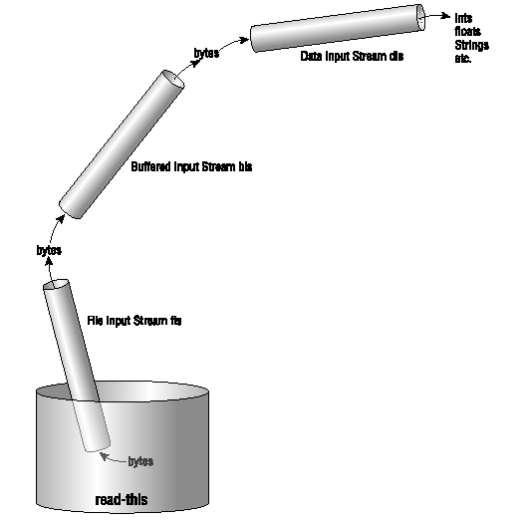
High-Level Filter Streams

Slide 15
High-Level Streams (2)
DataInputStream methods
  boolean readBoolean() throws IOException
  byte readByte() throws IOException
  char readChar() throws IOException
  double readDouble() throws IOException
  float readFloat() throws IOException
  int readInt() throws IOException
  long readLong() throws IOException
  short readShort() throws IOException
  String readUTF() throws IOException

Slide 16
High-Level Streams (3)
DataOutputStream is the symmetric version of DataInputStream.
DataOutputStream(OutputStream ostream)
  void writeBoolean(boolean b) throws IOException
  void writeByte(int b) throws IOException
  void writeBytes(String s) throws IOException
  void writeChar(int c) throws IOException
  void writeDouble(double d) throws IOException
  void writeFloat(float b) throws IOException
  void writeInt(int i) throws IOException
  void writeLong(long l) throws IOException
  void writeShort(int s) throws IOException
  void writeUTF(String s) throws IOException

Slide 17
High-Level Streams (4)
BufferedInputStream & BufferedOutputStream:
  use buffer memory to read and write blocks of data, increasing read and write performance
PrintStream:
  Can write text or primitives.
  The primitive type will be converted to bytes
  System.out & System.err are instance variables

Slide 18
Object Streams and Serialization
Object Streams are used for reading and writing objects
Serialization is the process of decomposing an object and converting it to a contiguous sequence of bytes - for data transmission in the distributed network enviroment.
  Serialized data only – not class definitions
  Snapshot of the object in memory.
  Static data does not serialize.
  Declare transient for non-serializable variables

Slide 19
Object Streams & Serialization
Example:
try {
FileOutputStream fos =new FileOutputStream(“xx.ser”);
ObjectOutputStream oos = new ObjectOutputStream(fos);
oos.writeObject(myVector);
oos.close();
fos.close();
}
catch (IOException e) { }

Slide 20
Object Streams and Serialization
Cont..
try {
FileInputStream fis =new FileInputStream (“xx.ser”);
ObjectInputStream ois = new ObjectInputStream(fis);
Vector vector = (Vector)(ois.readObject());
int b = ((Color)(vec.elementAt(2))).getBlue();
ois.close();
fis.close();
}
catch (IOException e) { }

Slide 21
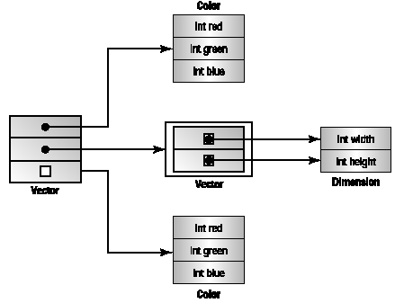
Object Streams and Serialization

Slide 22
The Serializable interface
Class declared implements Serializable to make it possible for serialization.
Serializable is a tag interface
  there is no method to override
public class Account implements Serializable{
private transient Date lastAccess;
private int accNo;
…
//
}

Slide 23
Exercise
Write an application that reads its own source file and prints out the statistics of characters frequency appear in the code
Add “saving function” for Student Management Application so that when the program ends, save the data to a file, when running the program will read the file again to recover old data.

Slide 24
Constructive questions
Why I/O in Java only used separate classes for read-write task but not for both?
Declare and initialize a variable of the I/O class to read a text file.
Want to read and write Student's score to a file, but can't find any method to read and write GPA score in FileReader/FileWriter or FileInputStream/FileOutputStream classes. Explain and suggest solutions.
Proposing a solution to save program running state and all data.. Without using DBMS.

Slide 25
Constructive questions
How to quickly identify a class in the java.io library used for what I/O purposes?
Why don't high level I/O classes have default constructor.. as is common in other classes?
Game applications often have a Save function that can save the state of the game and Load to reload an unfinished game. Suggest an I/O solution for this purpose.
How to exchange data between 2 computers in distributed applications in a network environment? An example of an online game.
What does the implements Serializable declaration mean?
What is the transient declaration used for? Give an example..

